Slide 1
Hash Tables
&
Hashing

Slide 2
Concept of Hash Table
In CS, a hash table, or a hash map, is a data structure that associates keys (names) with values (attributes).
  Look-Up Table
  Dictionary
  Cache
  Extended Array

Slide 3
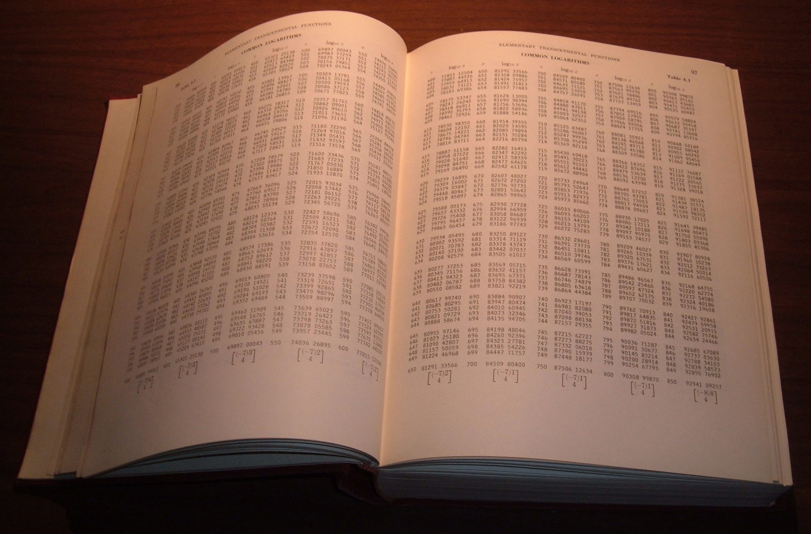
Remember Log Tables

Slide 4
The Dictionary

Slide 5
Dictionaries
Searching for the meaning of a word.
Each word in the dictionary has an associated meaning.
Here the word is the key and the meaning is the value.
All the key’s are arranged in alphabetical order, which makes retrieving of data easy and efficient.
But the implementation part i.e. arrangement of data differs from one data structure to another.

Slide 6
Dictionaries
Dictionaries store elements so that they can be located quickly using keys
Ex. Assume a dictionary that holds bank accounts
  each bank account is an object that is identified by an account number
  each bank account stores a lot of additional information
    the current balance,
    the name and address of the account holder, and
    the history of deposits and withdrawals performed

Slide 7
Dictionary - Operations
Operations usually performed on a dictionary are -
  Insert (Key, Value)
  Delete (Key)
  Get (Key)
  Elements () etc..

Slide 8
Dictionary - Implementation Options
Various data structures to implement dictionaries
  arrays, linked lists (inefficient)
  Hash tables
  Binary trees
  Red-Black trees
  AVL trees

Slide 9
Dictionary using Arrays and Linked Lists
A few sub-optimal ways to design this dictionary
  direct addressing - an array indexed on the key
    takes O(1) time,
    O(r) space - huge amount of wasted space
  a linked list - takes O(n) time, O(n) space
(null) | (null) | Jack | (null) | (null)
0000-0000 | 0000-0000 | 1234-5678 | 0000-0000 | 0000-0000
Jack
Jill
1234-5678
8765-4321

Slide 10
Hash Tables

Slide 11
Hash Table
Hash table
  Collection of pairs,
  Uses a lookup function (Hash function)
Hash tables are often used to implement associative arrays,
  Worst-case time for Get, Insert and Delete is O(size).
  Expected time is O(1).

Slide 12
Search v/s Hashing
Search tree methods use key comparisons
  Time complexity: O(size) or O(log n)
Hashing methods use hash functions
  Expected time complexity: O(1)
Types
  Static hashing
  Dynamic hashing

Slide 13
Search v/s Hashing
Consider the problem of searching an array for a given value
  If the array is not sorted, the search requires O(n) time
    If the value isn’t there, we need to search all n elements
    If the value is there, we search n/2 elements on an average
  If the array is sorted, we can use binary search
    Binary search requires O(log n) time
    Equally fast whether the element is found or not
  Can we do better?
    How about an O(1), that is, constant time search?
    We can do it if the array is organized in a particular way

Slide 14
Static Hashing
The Key-value pairs are stored in a fixed size table called a hash table.
  A hash table is partitioned into many buckets.
  Each bucket has many slots.
  Each slot holds one record.
  A hash function f(x) transforms the identifier (key) into an address in the hash table.

Slide 15
Hash table
s - slots
0
1
s-1
. . .
0
1
.
.
.
.
.
.
.
.
.
b - buckets
. . .
b-1

Slide 16
Hash Tables
A hash table is a data structure invented for very fast data storage and retrieval.
Goal is to look for data in a single step using the data itself to tell you where to look.
Like an array, but with a function to map the large range into one which we can manage.
  e.g., take the original key, modulo the (relatively small) size of the array, and use that as an index

Slide 17
Hash Tables
We use a hash function to map data values into table positions.
Example –
Insert (8904, Mickey) into a hashed array with, say, five slots
  8904 mod 5 = 4
(null) | (null) | (null) | (null) | Mickey
0 | 1 | 2 | 3 | 4

Slide 18
Hash Tables
Data lookup uses the same process - hash the query key, then check the array at that slot.
Example –
  Get (8904)
Hash functions are many to one, so it is possible that the hashing may map two or more values to the same position in the array.

Slide 19
Collisions
When we attempt to store a value and the location is already taken this is called a collision.
How to deal with two keys which hash to the same spot in the array?
Many collision resolutions options are possible,
  Chaining
  Linear Probing
  Double Hashing
  Buckets
We also need to modify the retrieval algorithm to handle such cases.

Slide 20
Hash Tables
Collision Handling -
Chaining

Slide 21
Collision Handling - Chaining
We can think of each table location as a “bucket” that contains several slots. Each slot is filled with one piece of data.
This approach involves “chaining” the data. This is a common approach when the hash table is used as disk storage.
For each element of the table, a linked list is maintained to hold data that map to the same location.
This list can grow as items are entered (unordered) or enter items into the list in a sorted fashion (for easier retrieval).

Slide 22
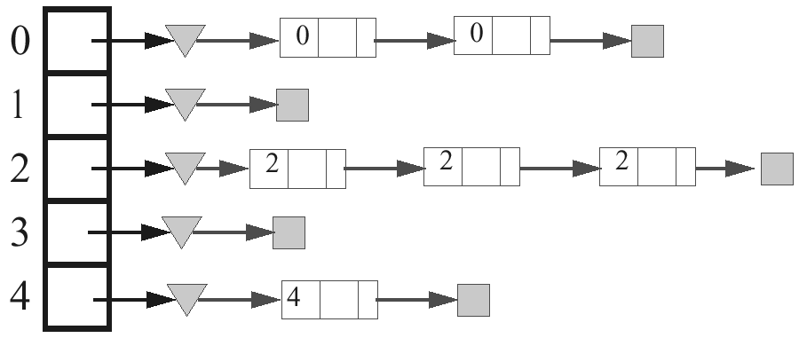
Collision Handling - Chaining
Use of chaining
  Set up an array of links (a table), indexed by the keys, to lists of items with the same key.
  Most efficient (time-wise) collision resolution scheme.

Slide 23
Collision Handling - Chaining
Instead of probing the hash table we can use a linked list or another dynamic structure to store collisions.
index
… |  |  |  |  |  |  |  |  |  |  |  | …
For Insertion/search/deletion we can use the existing linked list code
Since each list is very small, the operations take very few steps.
The table size for separate chaining can be smaller because the overflow space is in the linked list.

Slide 24
Hash Tables
Collision Handling –
Linear Probing

Slide 25
Collision Handling - Linear Probing
Have you ever been to a theatre or sports event where the tickets were numbered?
Has someone ever sat in your seat?
How did you resolve this problem?
Linear Probing involves seeing an item in the hashed location and then moving by 1 through the array, by circling to the beginning if necessary, until an open location is found.

Slide 26
Collision Handling - Linear Probing
Let’s say that we have 1000 numbered tickets to an event, but we only sell 400.
If we move the event to a smaller venue, we must also renumber the tickets.
The hash function would work like this,
  (ticket number) % 400.
  How many people can get the same hashed number?
  (say 3 - for example, tickets 42, 442, and 842)

Slide 27
Collision Handling - Linear Probing
The idea is that even though these numbers hash to the same location, they need to be given a slot based on their hash number index.
Using linear probing, the entries are placed into the next available position.
This is termed as rehashing.
The function for the rehashing is the following:
rehash (key) = (n+1) % k

Slide 28
Collision Handling - Linear Probing
Consider the data with keys: 24, 42, 34, 62, 73 into a table of size 10.
Hash function = key % 10
These entries can be placed into the table at the following locations,
 | 42 | 62 | 24 | 34 | 73

Slide 29
Collision Handling - Linear Probing
24 % 10 = 4. Position is free. 24 placed into element 4.
42 % 10 = 2. Position is free. 42 placed into element 2.
34 % 10 = 4. Position is occupied. Try next position(5). 34 placed into element 5.
62 % 10 = 2. Position is occupied. Try next position(3). 62 placed into element 3.
73 % 10 = 3. Position is occupied. Try next position(4), (5), Occupied, Try(6), 73 is placed into element 6.
 |  |  | 24
 | 42 |  | 24
 | 42 |  | 24 | 34
 | 42 | 62 | 24 | 34
 | 42 | 62 | 24 | 34 | 73

Slide 30
Collision Handling - Linear Probing
Example
  h(x) = x mod 13
  Insert keys 18, 41, 22, 44, 59, 32, 31, 73
0
1
2
3
4
5
6
7
8
9
10
11
12

Slide 31
Collision Handling - Linear Probing
Example
  h(x) = x mod 13
  Insert keys 18, 41, 22, 44, 59, 32, 31, 73
  Solution
0
1
2
3
4
5
6
7
8
9
10
11
12
41
18
44
59
32
22
31
73
0
1
2
3
4
5
6
7
8
9
10
11
12

Slide 32
Linear Probing - Insertion
If the location at index is “taken” probe the next locations until an open spot is found.
…
3
9
2
-1
…
index
Here we use -1 to mark an open spot in the table.
New data replaces the -1 and now that location is “taken”.
We must adapt our lookup to probe until -1 reached to check the locations adjacent to hash table index.

Slide 33
Linear Probing - Algorithm
If the current location is used, try the next table location
Advantages –
Uses less memory than chaining
  one does not have to store all those links
Slower than chaining
  one might have to walk along the table for a long time
LinearProbingInsert(k)
01 if (table is full) error
02 probe = h(k)
03 while (table[probe] occupied)
04 probe = (probe+1) mod m
05 table[probe] = k

Slide 34
Linear Probing - Lookup
Retrieve an element from the Hash Table
Lookups walk along the table until the key or an empty slot is found
This method provides good memory caching (if step-size is equal to one), through good locality of reference
This method also results in clustering, an very high probability that where there has been one collision there will be more.

Slide 35
Linear Probing - Deletion
… |  | 3 | 9 | 2 | 7 | deleted | …
index
A real pain to delete from
  Use lazy deletion, mark the deleted slot with “deleted” flag
  and search/insert be adjusted accordingly
  or
  Overwrite the slot with a -1
  or
  Fill in the slot by shifting remaining elements

Slide 36
Hash Tables
Collision Handling -
Double Hashing

Slide 37
Double Hashing
Similar idea to linear probing except the step size between probes is a function of the hash index.
eg: step = (index + 79) % 23 + 1
This will spread out the data records in case of collisions.
Probes should wrap around at the end of the table (using % operator).
Double hashing works best if the step size is relatively prime to table size.
… |  | 3 |  | 9 |  | -1 | …
index
Here, index = (index + step) % size

Slide 38
Double Hashing
Use two hash functions
If m is prime, eventually will examine every position in the table
Many of the same (dis) advantages as linear probing
Distributes keys more uniformly than linear probing
DoubleHashingInsert(k)
01 if (table is full) error
02 probe = h1(k)
03 offset = h2(k)
03 while (table[probe] occupied)
04 probe = (probe+offset) mod m
05 table[probe] = k

Slide 39
Example of Double Hashing
Consider a hash table storing integer keys that handles collision with double hashing
  N = 13
  h(k) = k mod 13
  d(k) = 7 - k mod 7
Insert keys 18, 41, 22, 44, 59, 32, 31, 73

Slide 40
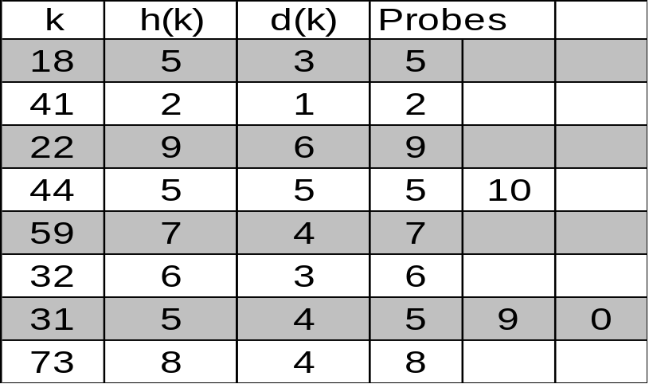
Double Hashing - Example
  N = 13
  h(k) = k mod 13
  d(k) = 7 - k mod 7
keys 18, 41, 22, 44, 59, 32, 31, 73
0
1
2
3
4
5
6
7
8
9
10
11
12
31
41
18
32
59
73
22
44
0
1
2
3
4
5
6
7
8
9
10
11
12

Slide 41
Storage and Retrieval
To store a record in hash table:
  calculate index.
  check array[index] is empty.
  store record in array[index].
  mark location as “taken”.
To retrieve a record from hash table:
  calculate index.
  check array[index] to see if not empty and key matches.
  return record from array[index] or a “not found message.

Slide 42
Hash Functions

Slide 43
Introduction
A hash function is a function that
  When applied to an Object, returns a number
  When applied to equal Objects, returns the same number for each object
  When applied to unequal Objects, is very unlikely to return the same number for each
Hash functions turn out to be very important for searching, that is, looking things up fast

Slide 44
Hash Functions
Need to choose a good hash function
  quick to compute
  distributes keys uniformly throughout the table
  good hash functions are very rare – birthday paradox
How to deal with hashing non-integer keys:
  find some way of turning the keys into integers
    for a string, add up the ASCII values of the characters of your string
  then use a standard hash function on the integers

Slide 45
Hashing
Suppose we were to come up with a magic function that, given a value to search for, would tell us exactly where in the array to look
  If it’s in that location, it’s in the array
  If it’s not in that location, it’s not in the array
This function would have no other purpose
If we look at the function’s inputs and outputs, they probably won’t “make sense”
This function is called a hash function because it “makes hash” of its inputs

Slide 46
Finding the hash function
How can we come up with this magic function?
In general, we cannot as there is no such magic function
  In a few specific cases, where all the possible values are known in advance, it has been possible to compute a perfect hash function
What is the next best thing?
  A perfect hash function would tell us exactly where to look
  In general, the best we can do is a function that tells us where to start looking!

Slide 47
Integer Hashing
Assume that we want to store/retrieve 100 student records by their ID.
We could allocate an array 4,000 use ID as the index, but this would waste a lot of space.
Instead, we can allocate an array 200 and use ID % 200 as our hash function.
eg: hash(2011003) = 3
…
0
1
2
3
4
199
student info for ID 2011003
We need to make sure the hash table size is larger than number of records we intend to store.

Slide 48
Hash Functions : Division Method
Use the remainder after division
  h(k) = k mod m
  Where k is the key and m the size of the table
Need to choose m
If the divisor is even and there are more even values, the hash function will produce an excess of even values. This is also true if there are an excessive amount of odd values.
However, if the divisor is odd, then either kind of excess of key values would still give a balanced distribution of odd/even results.
Thus, the divisor should better be odd. But, this is not enough.

Slide 49
Hash Functions : Division Method (2)
If the divisor itself is divisible by a small odd number (like 3, 5, or 7) the results are unbalanced again.
Ideally, it should be a prime number.
If no such prime number works for our table size, we should use an odd number with no small factors.

Slide 50
Hash Functions : Division Method (3)
Example
  h(k) = k mod m
  hash table for k = 2000 character strings
  we don’t mind examining 3 elements
  m = 701
    a prime near 2000/3
    but not near any power of 2
Further examples
  m = 13
    h(3)?
    h(12)?
    h(13)?
    h(47)?

Slide 51
Hash Functions : String Based
Goal is to spread index values uniformly around the hash table to reduce collisions.
There are many ways to do this with a string.
  add the ASCII codes for all characters in the string.
  convert string into a number base 256.
  select k characters from string and multiply ASCII codes by user defined position weights.
  eg. index = (str[2]*17 + str[3]*21 + str[6]*33) % size
t | o | m | y |  | j | e | r | r | y
0 | 1 | 2 | 3 | 4 | 5 | 6 | 7 | 8 | 9

Slide 52
Universal Hashing
For any choice of hash function, there exists a bad set of identifiers
A malicious adversary could choose keys to be hashed such that all go into the same slot (bucket)
Average retrieval time is Θ(n)
Solution
  a random hash function
  choose hash function independently of keys!
  create a set of hash functions H, from which h can be randomly selected

Slide 53
Writing your own hashCode()
A hashCode() method must:
  Return a value that is (or can be converted to) a legal array index
  Always return the same value for the same input
    It can’t use random numbers, or the time of day
  Return the same value for equal inputs
    Must be consistent with your equals method
It does not need to guarantee different values for different inputs

Slide 54
Writing your own hashCode()
A good hashCode() method should:
  Make it unlikely that different objects have the same hash code
  Be efficient to compute
  Give a uniform distribution of values
  Not assign similar numbers to similar input values

Slide 55
Other considerations
The hash table might fill up; we need to be prepared for that
  Not a problem for a bucket hash, of course
You cannot easily delete items from an open hash table
  This would create empty slots that might prevent you from finding items that hash before the slot but end up after it
  Again, not a problem for a bucket hash
Generally speaking, hash tables work best when the table size is a prime number

Slide 56
Efficiency
Hash tables are actually surprisingly efficient
Until the table is about 70% full, the number of probes (places looked at in the table) is typically only 2 or 3
Sophisticated mathematical analysis is required to prove that the expected cost of inserting into a hash table, or looking something up in the hash table, is O(1)
Even if the table is nearly full (leading to occasional long searches), efficiency is usually still quite high

